Slide 1
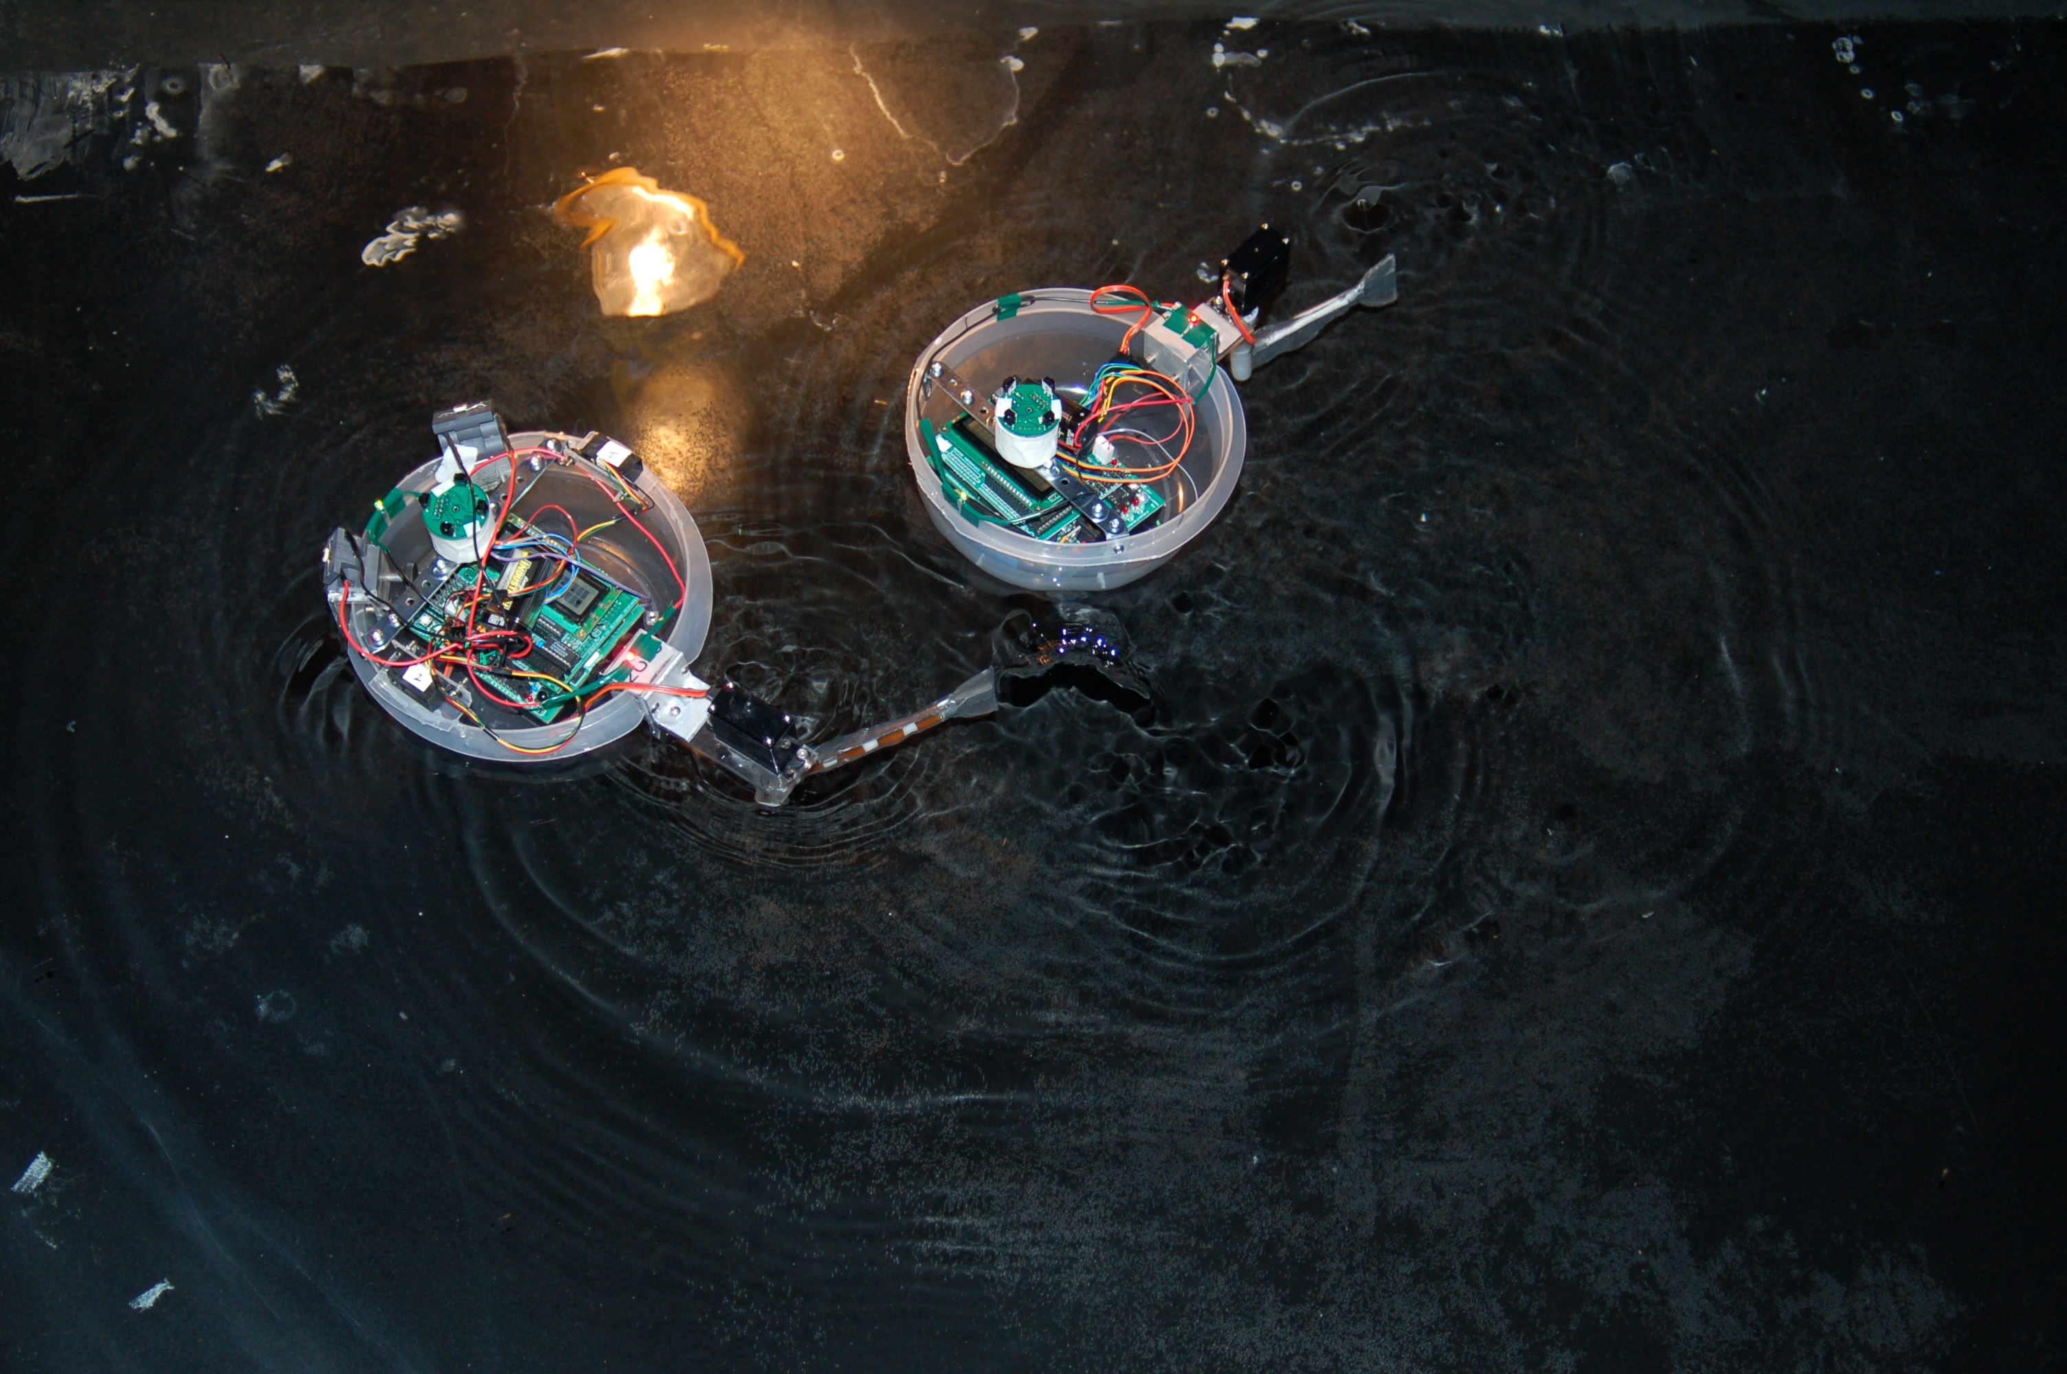
Vertebrate Evolution:
Testing Adaptation Hypotheses using Biorobotics

Slide 2
Using Artificial Life to Study Extinct Life

Slide 3
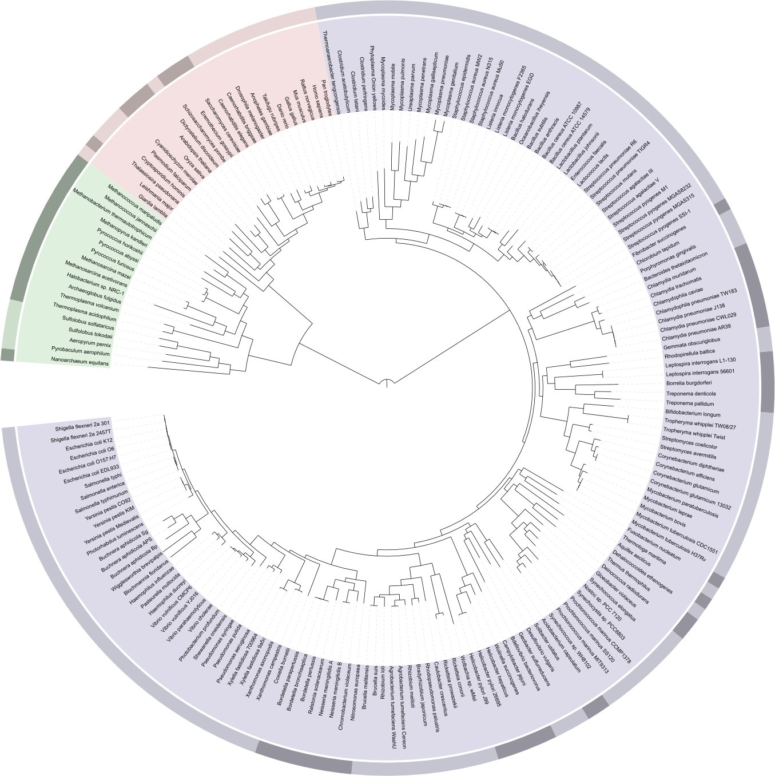
Study life as it was.

Slide 4
Trait-level Information
1. Genetics (type, heritability, interactions).
2. Polarity (ancestral and derived states).
3. Function in the ecological situation.
1. Population structure (demography, gene flow).
2. Selection environment (spatial & temporal patterns).
3. Responses to selection in that environment (outcomes).
Population-level Information
Ideal explanations of adaptation
Brandon, R. (1990). Adaptation & Environment

Slide 5
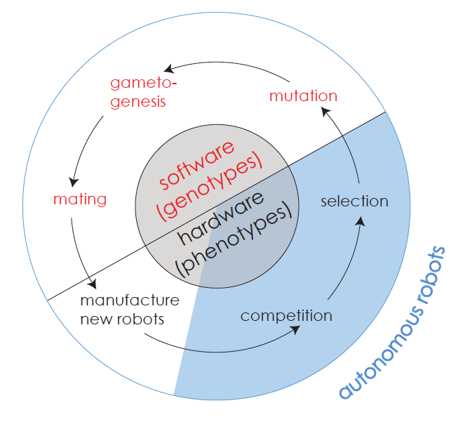
The Artificial Life Cycle for Biorobotics
Solution? ALife

Slide 6
The Artificial Life Cycle for Biorobotics
Solution? ALife
1. Genetics.
2. Polarity
3. Function in the ecological situation.
1. Population structure.
2. Selection environment.
3. Responses to selection in that environment

Slide 7
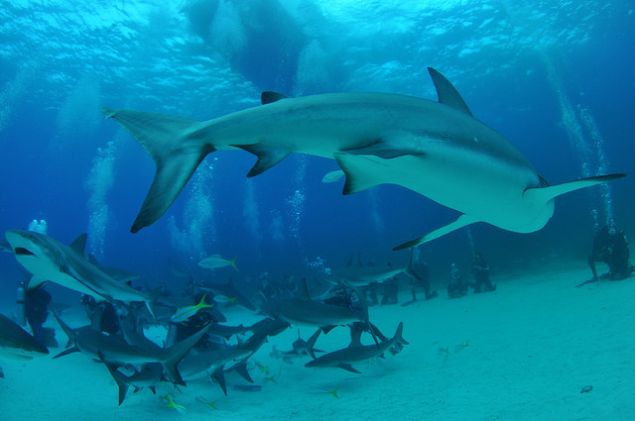
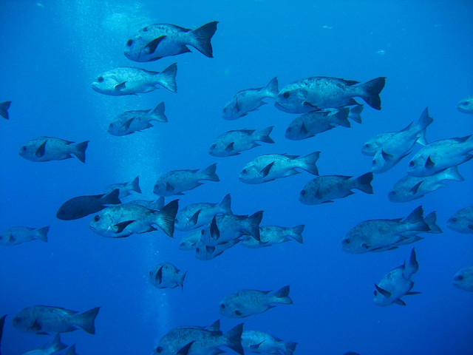
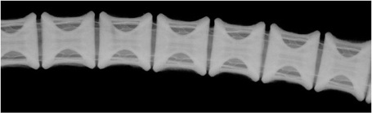
Question: Why did vertebrae evolve multiple times independently?
Photo by Flickr user hankplank
Photo by Flickr user tobze
Radiograph by Marianne Porter

Slide 8

Hypothesis: Vertebrae are an adaptation for enhanced predator avoidance during foraging

Slide 9
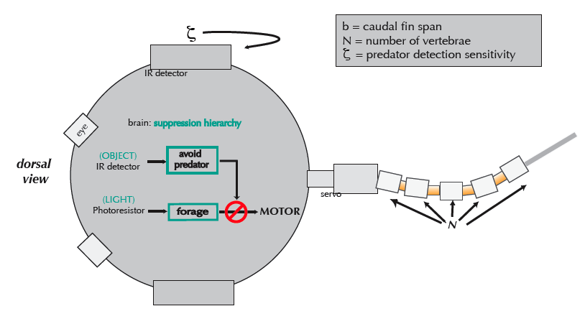

Slide 10
biomimetic notochord
porcine gelatin crosslinked in 1.0 % glutaraldehyde
+
+
=
Delrin™
ring vertebrae
insert and caudal fin
b
artificial vertebral column

Slide 11
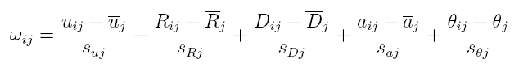
1
Prey
10
50
relative fitness, ω, rewards —
foraging
u, average velocity (ms⁻¹)
R, average distance from light (m)
predator avoidance
D, average distance from predator (m)
a, peak escape acceleration (ms⁻²)
θ, startle responses
40
60
escape
30
20
70
50
40
20
30
80
160
160
60
90
100
100
10
The individuals with the top three ω’s are awarded 6, 4, and 2, gametes, respectively, for the mating pool.
70
For individual i in generation j. Population size = 6.
1
Predator
80
90

Slide 12
meiosis and
mutation
randomized
mating
new
individuals
haploid gametes
selection
N
b
N
b
N
b
ζ
ζ
ζ
diploid
parents
reproductives
gene pool
diploid offspring
offspring
n = 6
n = 3
n = 12
n = 6
n = 6

Slide 13
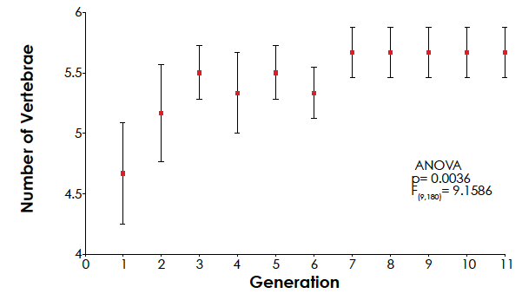
N, number of
vertebrae

Slide 14
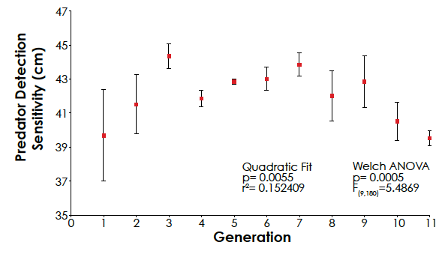
ζ, predator
detection
threshold
(mm)

Slide 15
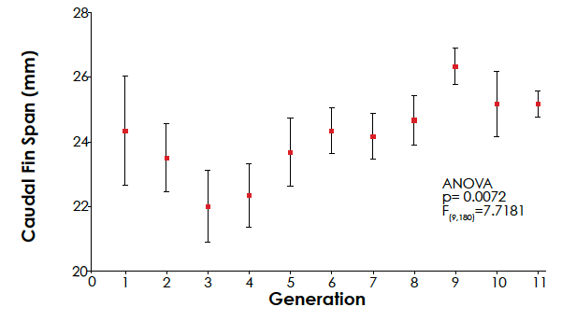
b, caudal fin
span (mm)

Slide 16
